Slide 1
Marketing Planning Process
Dr. Lisa Watson
BUS 100 Team Instructor

Slide 2
General Business Environment
Context/climate (5Cs): PESTLE (Ch.1-2)
political, economic, socio-cultural, technological, legal/regulatory, environmental
Industry Environment (5Cs)
Company (5Cs)
Structures and Entrepreneurship (Ch. 4)
Ethics (Ch. 3)
Customers
Competitors
Collaborators
(incl. channels)
Management Functions (Ch.6)
Planning
Organizing
Leading
Controlling
Functional Areas
HR (Ch. 8-9)
Marketing (Ch. 12-13)
Operations (Ch. 10)
Accounting (Ch. 11)
Finance (Ch. 14)

Slide 3
Why Study Marketing?
80%
of all new consumer products
FAIL
(Marketing is about improving your chances of being in the other 20%)

Slide 4
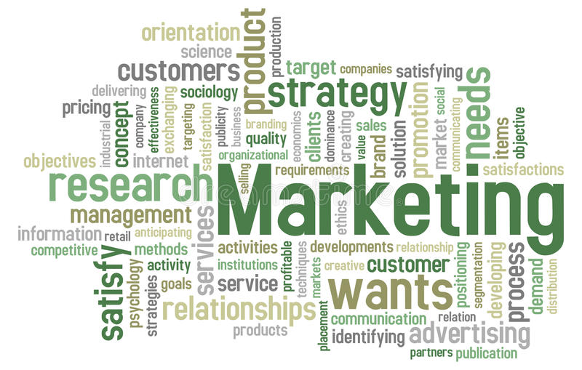
What is (& isn’t) Marketing About?

Slide 5
Marketing Planning Process (STP & the 4Ps)
Identify the Opportunity
Need/want/opportunity/challenge or PAIN (market focus)
Situation Analysis
E-scan, 5Cs, Porter’s 5 Forces, SWOT, micro/macro-environments
Marketing Strategy: STP (Value Proposition)
Segmentation: dividing market into smaller homogenous groups
Marketing Tactics: 4Ps (Marketing Mix)
Price: market value versus costs, brand equity
Place: logistics, distribution channels
Promotion: What and where you communicate
Product: new product development, total product issues
Marketing objectives: sales, market share, etc. (company focus)
Targeting: Selecting customer segment(s) to target whose needs you think you can meet
Positioning: What will make your brand better/different than competitors targeting the same segment(s)
Marketing Research
Notes:
Discuss connections with Entrepreneurship class and four facets of an opportunity: unique/value added, attractive (market size), timely (why now?), durable (will it last?)

Slide 6
The Marketing Orientation
People Don’t Buy Products
They Buy Benefits (solutions to problems)
Why do people buy toothpaste?
To have a substance to rub over their teeth with a brush each morning?
Cavity prevention, whiter teeth, fresher breath, etc.

Slide 7
Identifying Opportunities to Meet Unmet Needs/Wants
Marketing is about understanding people
Marketers have to be able to look at the world through consumers’ eyes in order to
Identify needs/wants that aren’t being met (create value)
Improve existing products to better meet people’s needs/wants (add value)
Be aware of what is happening around you
Look at changes occurring in the environment (e-scan)
Listen to people around you (like informal market research)

Slide 8
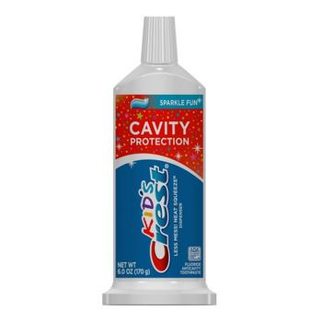
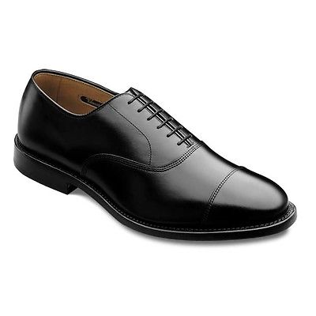
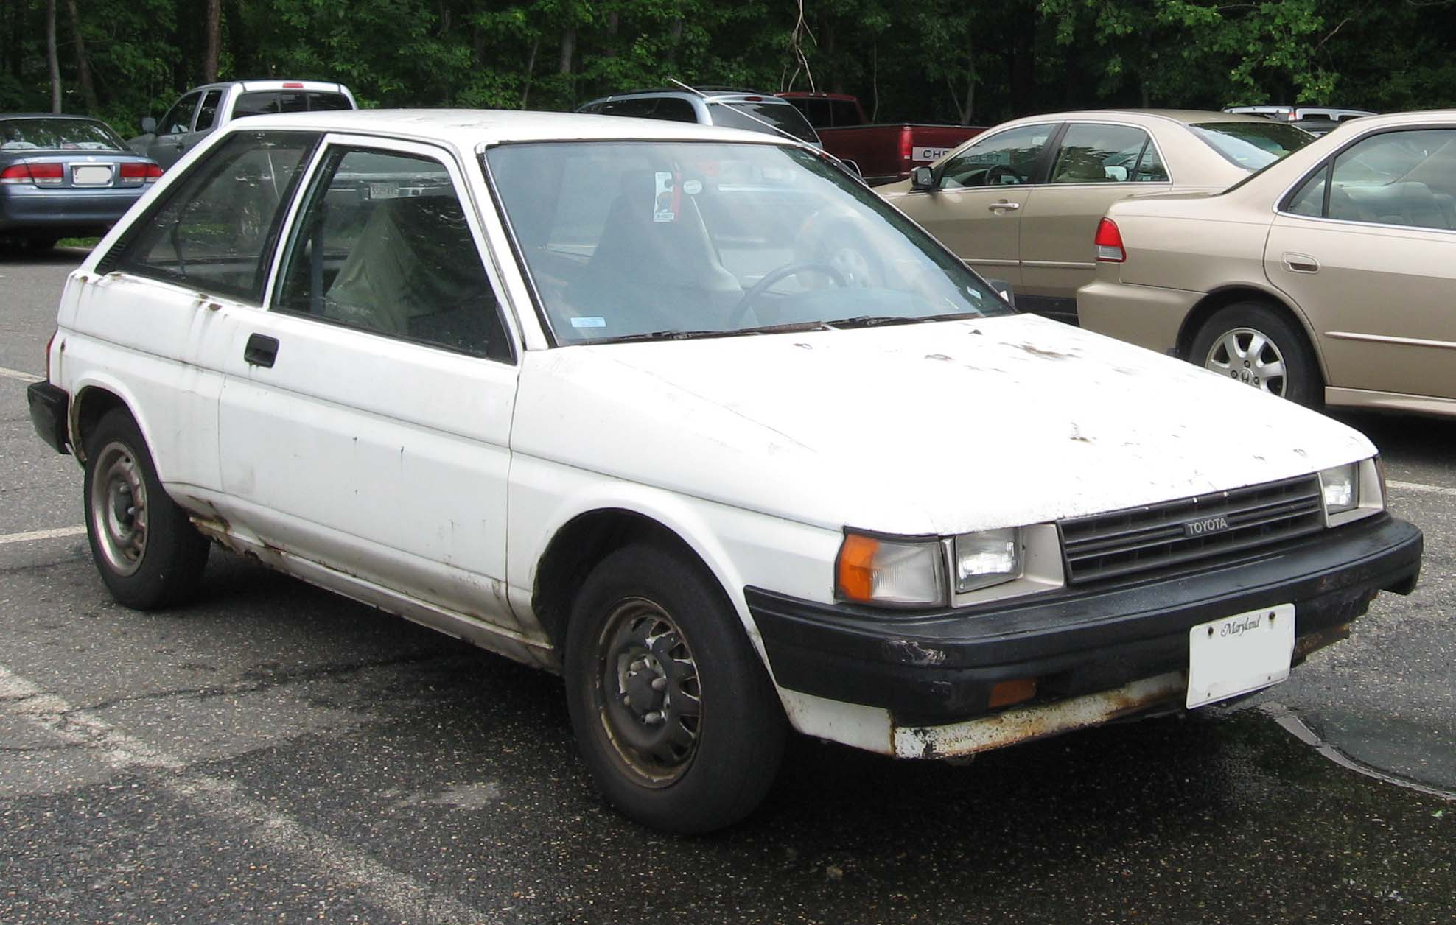
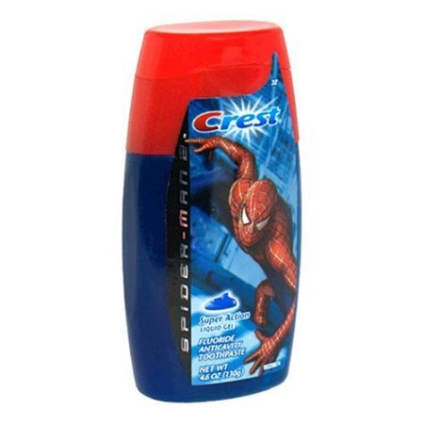

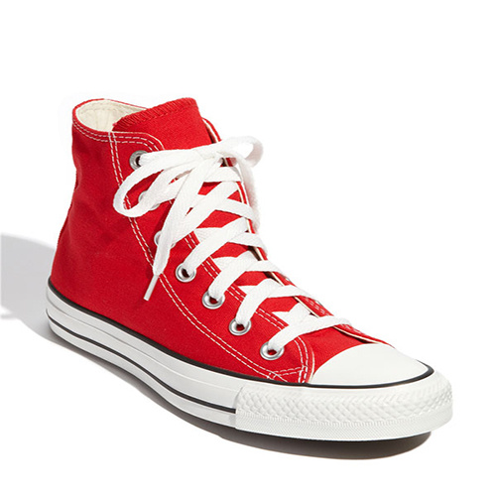
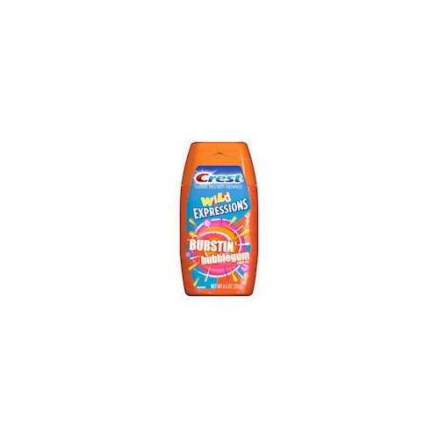


Categories of Consumer Needs/Wants/Benefits
Functional
Externally generated usage- related problems
Symbolic
Internally generated needs for self- enhancement, role position, group membership, or ego-identification
Experiential
Internally generated need for stimulation and variety
Notes:
Car example and how different people look for different benefits from the same product

Slide 9


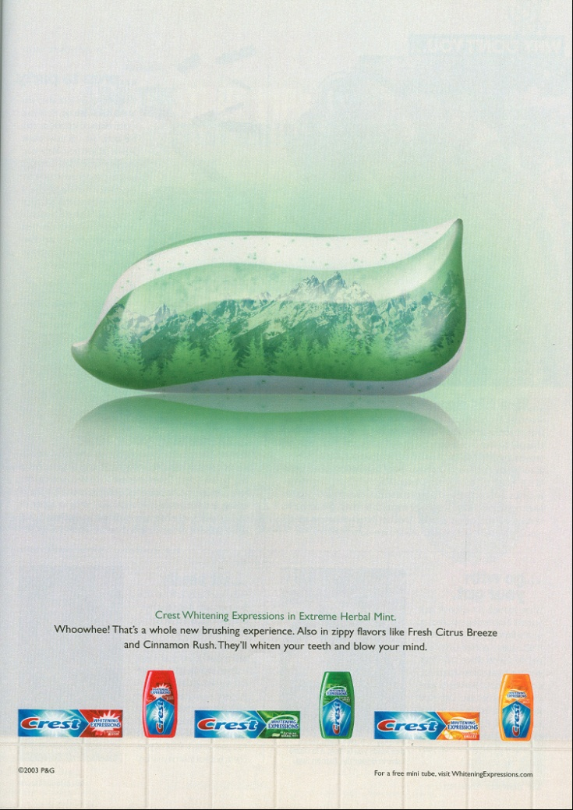
Communicating Product Benefits

Slide 10
Segmentation Methods
Geography
Demography
Behaviour/usage
Psychographics
Benefit Sought
Used together to define and describe, segmentation is a marketer’s most powerful tool for understanding its customers and potential customers

Slide 11
Positioning
How consumers think about your product relative to competitors
Where you are positioned in their minds
Comparison of product attributes
Beware the price/quality fallacy
Whitening
High
Crest
Colgate
Sensodyne
Pronamel
Reduces
sensitivity
High
Low
Arm & Hammer
Low

Slide 12
The Value Proposition
The unique benefit
that your firm’s product¹ provides
to a particular target market segment
better/differently than your competitors
A Clear Value Proposition is Central to Every Marketing Strategy
¹ Products can include goods, services, ideas and experiences

Slide 13
Your Toolkit: Marketing Mix (4Ps)
Product
Features, branding, warranties, service, etc.
Price
How much to charge relative to competitors
more about perceived value than costs
Place (distribution)
Convenience: where and when you want it
Logistics, retail location, hours, shipping/parking, etc.
Promotion
Marketing communication: promotional mix
advertising, public relations, word of mouth media, direct marketing, sales promotion

Slide 14
Thank you! Any More Questions?
Marketing Planning Process
Dr. Lisa Watson
BUS 100 Team Instructor

